Slide 1
Big Data and HR Metrics
Dr.G. Sivanesan
Associate Professor
Notes:
1

Slide 2
Some Key Terms
- Employee Engagement
- Big Data
- HR Metrics
- HR Analytics

Slide 3
Employee Engagement
Our working definition…
Employee engagement is the emotional commitment the employee has to the organization and its goals

Slide 4
What is Big Data?
Notes:
4

Slide 5
What are HR Metrics?
Notes:
5
HR Metrics is the name we apply to what we have probably been doing all along. Collecting data, producing reports, and monitoring HR activities.

Slide 6
Question
What Metrics do you track?
Notes:
6

Slide 7
Benefits of HR Metrics
Feedback is required for continuous learning
Accountability ‘What gets measured gets done’
Quantify the value of HR
Guide workforce strategies
Maximize HR’s return on investments
Show what HR contributes to business results
Make the business case for HR’s objectives
Notes:
7

Slide 8
Challenges with Metrics
“You can’t measure what we do…”
Lack of clear purpose for measuring
Lack of cooperation between departments
Difficulty extracting data from multiple systems
Difficulty understanding and analyzing metrics
Numbers used to draw inaccurate conclusions
Notes:
8

Slide 9
What Are Analytics
Analytics use statistics to identify relationships between data sets to help firms address problems and make talent decisions.
Most HR organizations have been slow to adopt analytics – too slow, in fact, in the minds of many impatient business leaders.
For example, while ~50% of companies are using Online Assessments…just 14% of HR organizations in the U.S are using predictive analytics to make talent decisions (Bersin by Deloitte’s study, 2013).
Notes:
9

Slide 10
What can HR Analytics help us to solve?
Staff Churn
Productivity
Sales Target
Achievement
All sorts of business problems that involve people…
But first you need to have the relevant data sources.

Slide 11
Employee Engagement
Research has shown it to be linked to important outcomes:
- Discretionary effort
- Job performance
- Employee retention
- Innovation
- Adapting to change
- Revenue & profitability
- Customer experience
Employee Engagement data shows you a snap shot in time about the current state of Workforce Engagement.

Slide 12
Predictive Analytics Applied to
Employee Engagement Data & Big HR Data
Can help Your Internal clients’ solve critical problems and answer burning questions
It is not a complex as it seems,
but it requires a bit of statistics skills.
Notes:
12

Slide 13
Big Data Meets
Predictive Analytics
what happens when we look at a metric for one thousand candidates?
13
Notes:
13

Slide 14
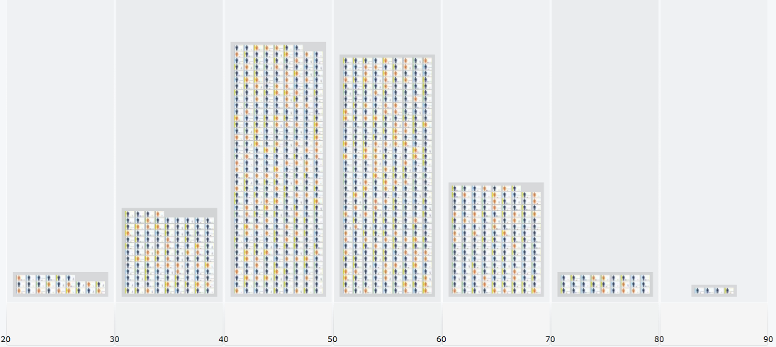
Predictive Analytics
14
14
Notes:
14

Slide 15
Bell Curve
Average
15
15
Notes:
15

Slide 16
Correlations (r)
10
9
r = + 0.44
n = 16,948
USA population
8
7
height
6
5
4
3
2
1
Correlations(r) from +1.0 to -1.0
0
0
1
2
3
4
5
6
7
8
9
10
weight
Notes:
16

Slide 17
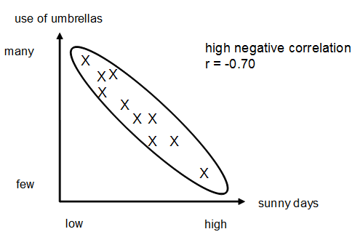
Negative Correlation
Example Use of Umbrellas
Correlations(r) from +1.0 to -1.0
Notes:
17

Slide 18
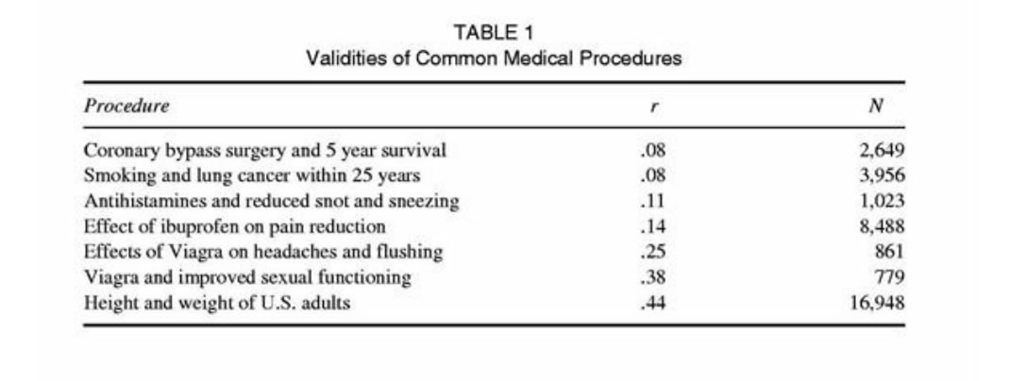
Correlations of common
medical procedures & outcomes

Slide 19
Regression Line (prediction)
10
9
8
7
height
6
5
4
3
2
1
0
0
1
2
3
4
5
6
7
8
9
10
weight
Notes:
19

Slide 20
Antecedents of
Employee Engagement
Talent Acquisition & Onboarding
- Person-Organizational Fit
- Person- Job Fit
- Setting realistic work expectations
- Fostering positive work relationships
Talent Development
- Training & career development opportunities
- Supervisor development & coaching oriented
- Feedback loops
Leadership
- Supervisor as a people leader (positive leadership traits)
- Psychological safety - work climate in which employees can thrive
- Employees empowered to make important decisions
Org Practices
- Perceived organizational support, justice and fairness
- Merit based recognition & rewards
- Flexibility in work-life arrangements

Slide 21
HR Analytics
Start Small…Baby Steps
Notes:
21

Slide 22
Analyzing Data
Microsoft Excel
Formulas
Sum
Average & Median
Time Calculations
Correlations
Regressions
Notes:
22

Slide 23
Simple HR Analytics
with MS Excel
Notes:
23

Slide 24
Excel Tips
Select a Column or Row: Left click on very top of column (or far left end of row) and it will highlight the whole column (or row).
Average Formula: = average(A1, A2, A3)
Correlation Formula: =CORREL(array1, array2)
Note: an Array is any column (or a row) you select.
Formulas can be copied/pasted but you want to use ‘$’ to lock down certain columns.
Notes:
24

Slide 25
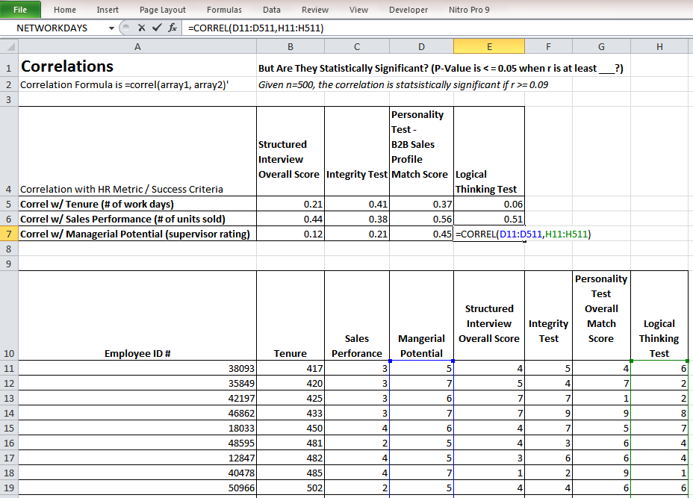
Excel Tips
Select a Column or Row: Left click on very top of column (or far left end of row) and it will highlight the whole column (or row).
Average Formula: = average(A1, A2, A3)
Correlation Formula: =CORREL(array1, array2)
Note: an Array is any column (or a row) you select.
Formulas can be copied/pasted but you want to use ‘$’ to lock down certain columns.
Notes:
25

Slide 26
Simple Reporting
Microsoft Excel (or equivalent)
Reports
Tables
Bar Graphs
Pie Charts
Scatter Plots
Warning:
Do not show your internal client a big
Excel file spread sheet with lots of data!
Notes:
26

Slide 27
Execs Like Dashboards !
If you can visually present in an intuitive way the impact that multiple variables have on a key outcome, you will more easily make your point to the Executive Leadership Team.
MS Office or equivalent are fine…..but there are also some really “Geeky Cool” Data Visualization tools available these days.
Notes:
27

Slide 28
Excel & PPT
Example of Using
MS Office for Dashboard:
A Business Case
on Selecting Salespeople

Slide 29
New Sales Goal Achievement
An Excel Bar Graph
Percentage of New Sales Target Achievement
High match score candidates achieved 98% of their sales target
Moderate match score candidates achieved 63% of their sales target
Low match score candidates only achieved 32% of their sales target

Slide 30
Closed Sales From Referrals
An Excel Pie Chart
# of New Sales from Salesperson’s Registered Referral Sources
High score candidates closed 63% of all the referrals sales
Moderate score candidates closed 32% of all the referral sales
Low score candidates only closed 5% of all the referral sales

Slide 31
Difference in Tenure
PPT Special Font for Emphasis
The average tenure for both
High and Moderate match score
candidates was at least
that of the Low match score candidates
Double

Slide 32
Dashboards w/ Cool Data Viz Software
Sunburst of Engagement Scores by Team Hierarchy
Source: OrgVue
Notes:
32

Slide 33
Get Started Now – Easy Steps
Find a leader with a problem
Persuade him/her to let you use analytics to help solve it
Figure out what metrics/outcomes may be relevant predictors & then collect the data
Create a combined score (regression formula) that predicts the desired outcome
Initiate the intervention based on what you have learned and measure change of performance over time
Notes:
33

Slide 34
HR Analytics Team Wanted
Find a business leader who is willing to partner on an analytics project to solve a problem (e.g. reducing turnover or accidents)
Create a project team (e.g. borrow talent from other departments, leverage the local Univ. or a supplier)
Get a small win and then promote its success
Repeat above process a few times to collect some small wins and build credibility with business leaders
Notes:
34

